Slide 1
Data Science Engineering with Python
Netflix Data Analysis

Slide 2
Agenda
Analysis of Netflix Dataset
Premise/Problem Statement
Data Source & Description
Findings/Visualization
Conclusion

Slide 3

Lights - Camera - Action
OTT: Over The Top” and refers to any streaming service that delivers content over the internet.
Rise of the OTT era during pandemic
Explosive growth in the recent years
Notes:
What is OTT platform?
OTT stands for “Over The Top” and refers to any streaming service that delivers content over the internet. The service is delivered “over the top” of another platform, hence the moniker.
With the outbreak of COVID-19 various lockdown policies around the world, OTT has become one of the few remaining – but much-needed – sources of entertainment these days. This explains its explosive growth in the recent years

Slide 4
Premise/ Problem Statement
Analyse
Analyse the different types of content hosted on the Netflix platform.
Derive
Derive popular content based on various attributes.
Explore
Explore Covid impact on new content launch.
Determine
Determine the top-voted content amongst viewers and movie aficionados.
What are the criteria for best selling movie/series types?

Slide 5
Data Source & Description
Data consists of different attributes such as Title, Classification of the content namely Movies or Series, Scores and Votes, Viewer ratings etc.
Dataset link - https://www.kaggle.com/datasets/syedmubarak/netflix-dataset-latest-2021

Slide 6
Scope of Analysis
Movies/Series
Boxoffice
IMDb Rating
Popular Directors
Runtime
Top Series
Top Movies
View Rating
Analyzing the content by its characteristics
Drawing correlations between different attributes
Characteristics of Netflix Content

Slide 7
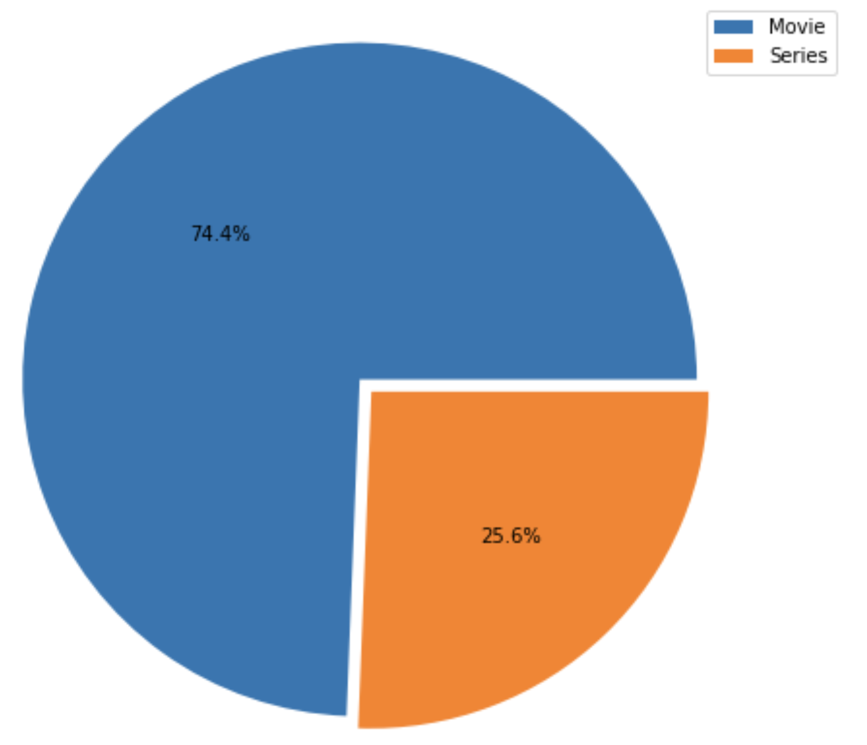
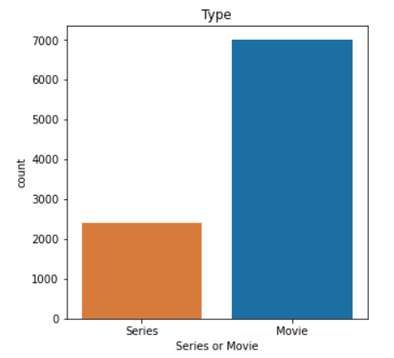
Movies vs. Series
Total content: +9K
Movies dominate this space.

Slide 8
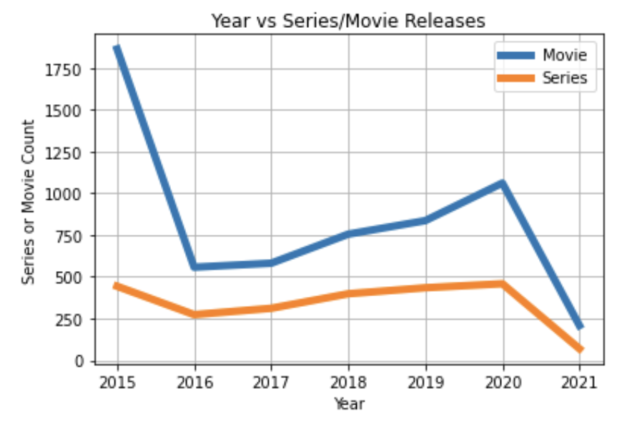
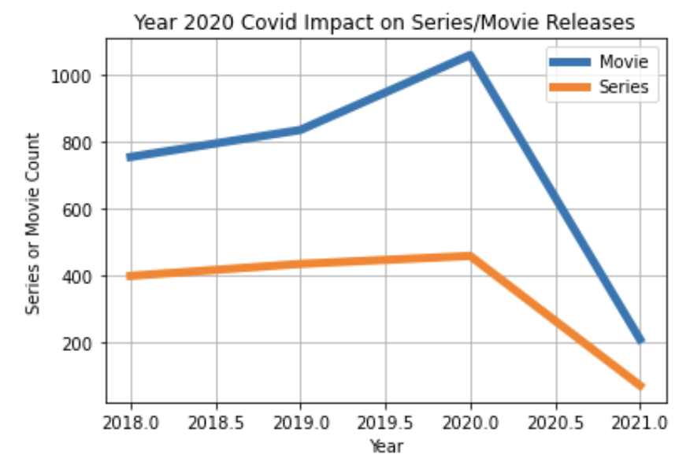
Year vs. Releases
Stable increase in content since the launch in 2015 until the year 2020.
Steep decline in content release following 2020 Covid-19 impact.

Slide 9
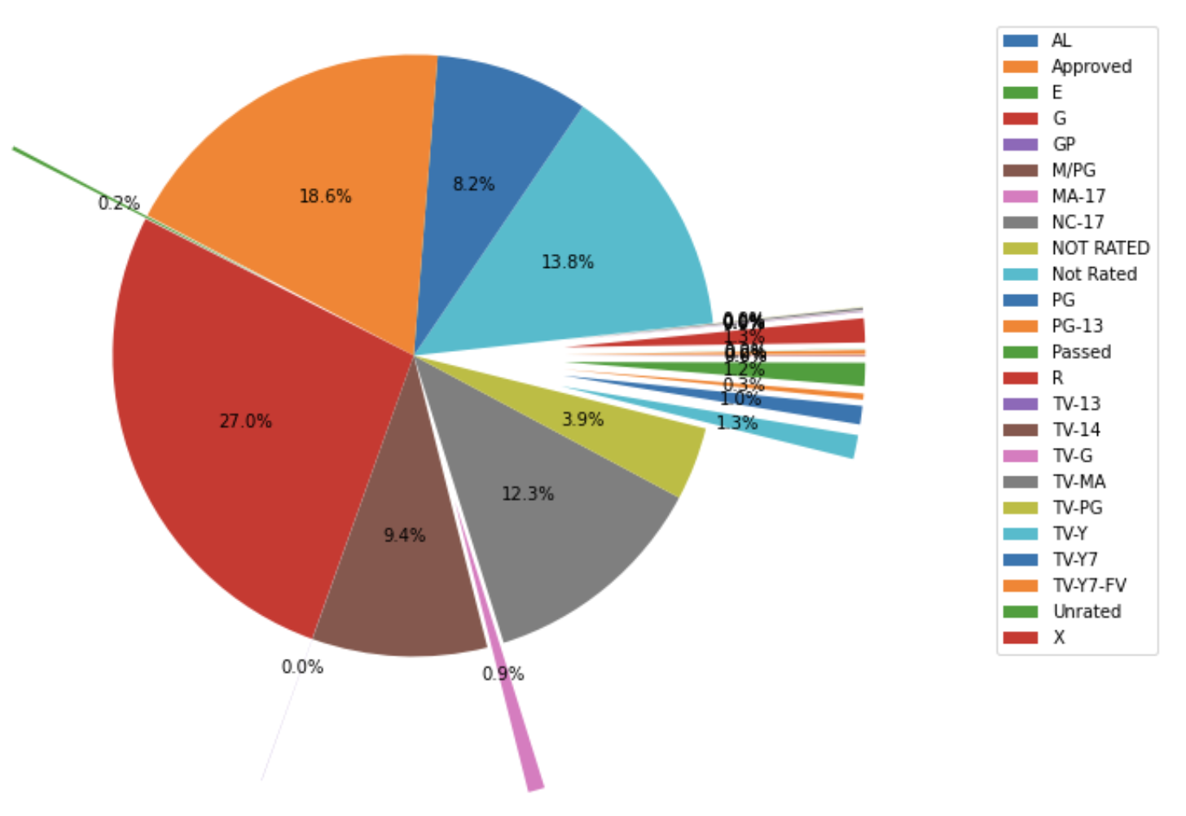
Viewer Ratings
Rates the suitability of TV broadcasts, movies, comic books, or video games to its audience.
Number of different categories, to show which age group is suitable to view media and entertainment.

Slide 10
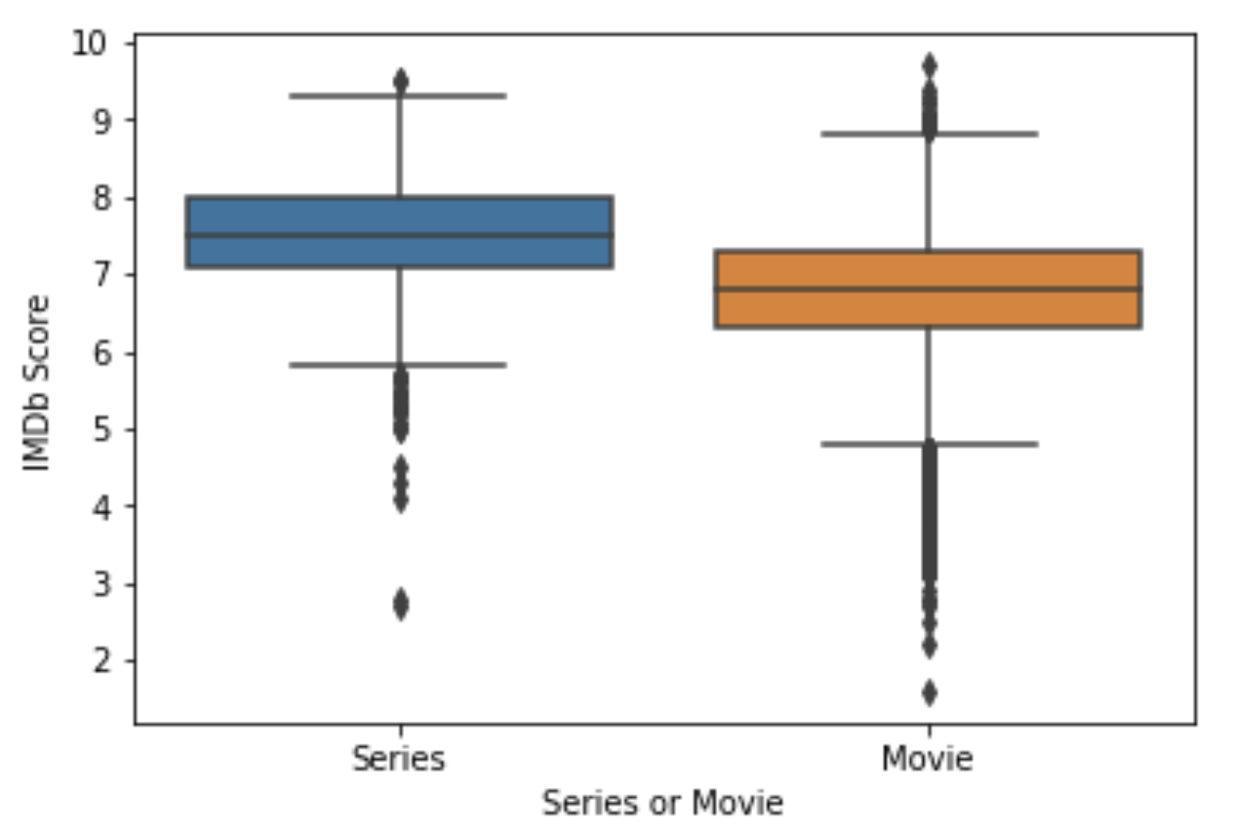
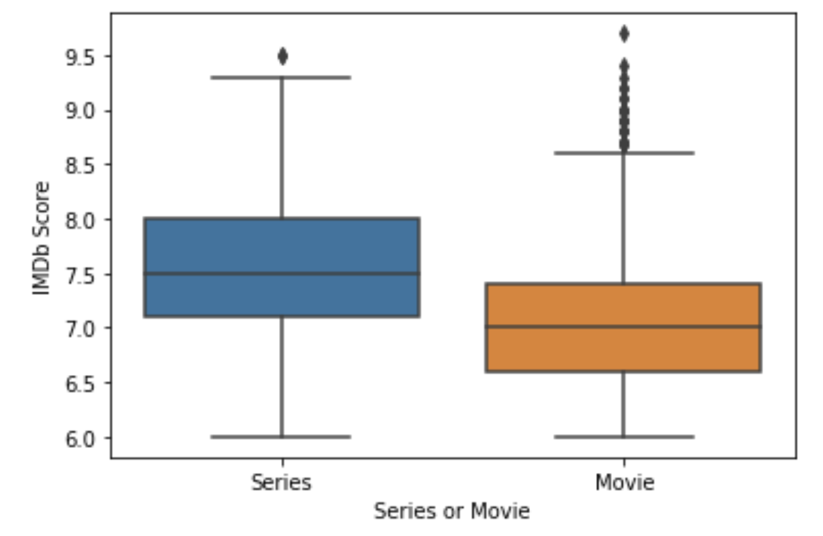
Audience Rating (IMDb Score)
Average content rating:
Movies: Between 6.5 to 7.5
Series: Between 7 to 8
Content with audience rating of 6.0 and below are identified as outliers here and removed.
However, content above rating of 8.5 are retained as these are marked as highly rated.

Slide 11
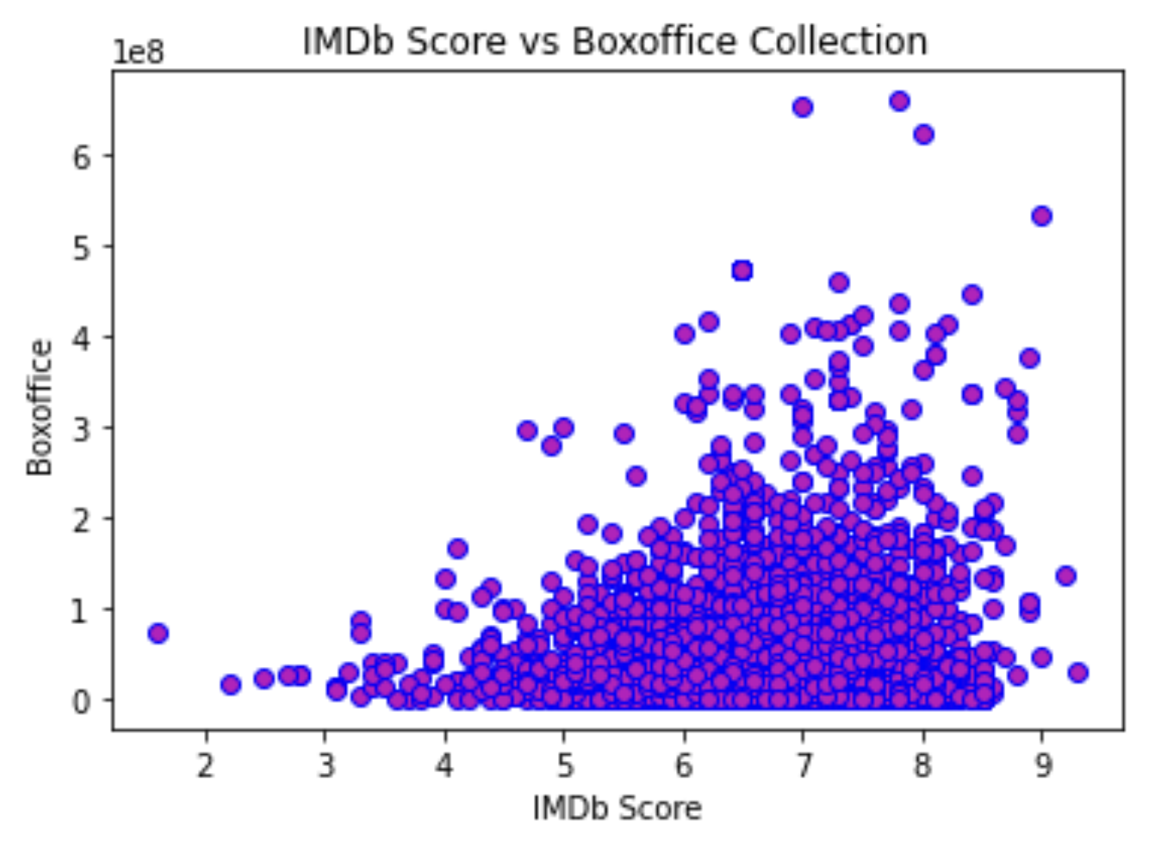
IMDb Score vs. Boxoffice
Higher the IMDb Score = Higher the Boxoffice collection
Concentrated around >6 IMDb rating and above $100M and $300M Boxoffice collection

Slide 12
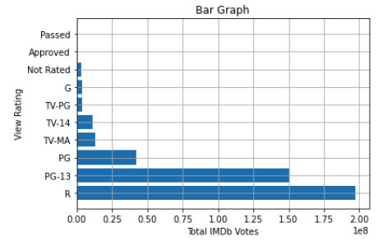
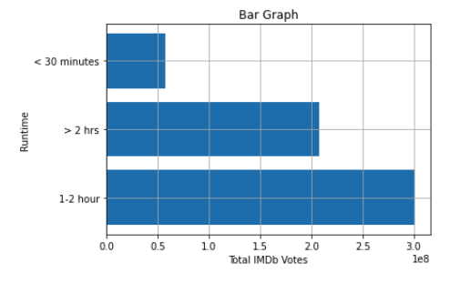
IMDB Rating vs View Rating vs Runtime
View Rating vs IMDb Votes
Year considered: 2018 to 2022 to be relevant to current trends
IMDb Votes considered: ++ 100K votes
Runtime vs IMDb Votes

Slide 13
Key Findings
Scope to include more Series content
Significant impact on content database due Covid-19
Most watched content is rated R, PG-13
Higher the IMDb score indicates higher Boxoffice collection which in turn could boost viewership.
Runtime impacts viewership.

Slide 14
Conclusion
Based on the Key Findings, viewers prefer:
Runtime of 1-2 hours (over 30 minute or > 2 hours)
Rating: R – Restricted, PG-13 (over other viewer ratings)
Director | IMDb Votes | Title | View Rating | Runtime
Quentin Tarantino | 1831004.0 | Fiction | R | 1 - 2
James Cameron | 996880.0 | Честное пионерское | R | 1 - 2
Todd Phillips | 951938.0 | Joker | R | 1 - 2
David Fincher | 863582.0 | Girls Revenge | PG-13 | 1 - 2
Steven Spielberg | 837936.0 | Me & You vs The World | R | 1 - 2
Top Movies
Director | IMDb Votes | Title | View Rating
George Lucas | 733336.0 | Im Standing on a Million Lives | PG
James Cameron | 654147.0 | Aliens R | R
Marc Forster | 602843.0 | Worlds Most Wanted | PG-13
Quentin Tarantino | 520333.0 | The Hateful Eight: Extended Version | R
Terry Gilliam, Terry Jones | 502049.0 | Monty Pythons Fliegender Zirkus | PG
Top Series
Notes:
Im Standing on a Million Lives PG 795 Aliens R 1015 Worlds Most Wanted PG-13 2895 The Hateful Eight: Extended Version R 7444 Monty Pythons Fliegender Zirkus

Slide 15
Thank You

Slide 16


Boxoffice Collection

Slide 17
Report Summary
Importing Python Libraries/Statements
Reading the Netflix dataset
Analysing the Original Dataset:
Understanding Basic information and stats about the dataset
Identifying Outliers and Null values
Cleaning the Original Dataset:
Deleting irrelevant columns.
Cleaning individual columns.
Removing Null values.
Removing Outliers
Data Visualization:
Using Pie Chart, Box Plot, Scatter Plot, Line Chart, Density Plot, Bar Graph
Using Visualisation technique to find correlations between attributes.
Movie and Series, View Rating, Popularity based on Votes and Scores
Interpretation
Characteristics of Best Selling Movies/Series

